Slide 1
METHOD OVERRIDING

Slide 2
WHAT??
If subclass (child class) has the same method as declared in the parent class, it is known as method overriding in Java.
If a subclass provides the specific implementation of the method that has been declared by one of its parent class, it is known as method overriding.
Method overriding is used for runtime polymorphism

Slide 3
Rules for Java Method Overriding
The method must have the same name as in the parent class
The method must have the same parameter as in the parent class.
There must be an IS-A relationship (inheritance).

Slide 4
//Creating a parent class
class Vehicle{
void run(){System.out.println("Vehicle is running");}
}
//Creating a child class
class Bike extends Vehicle{
public static void main(String args[]){
//creating an instance of child class
Bike obj = new Bike();
//calling the method with child class instance
obj.run();
}
}

Slide 5
Example of method overriding
//Creating a parent class.
class Vehicle{
//defining a method
void run(){System.out.println("Vehicle is running");}
}
//Creating a child class
class Bike2 extends Vehicle{
//defining the same method as in the parent class
void run(){System.out.println("Bike is running safely");}
public static void main(String args[]){
Bike2 obj = new Bike2(); //creating object
obj.run();//calling method
}
}

Slide 6
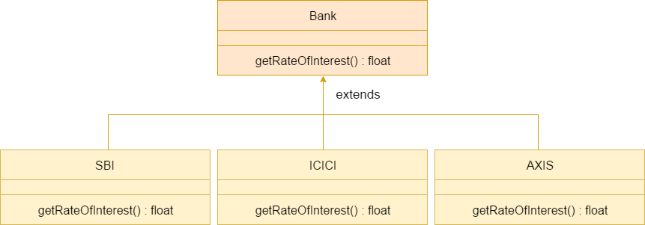

Slide 7
 | Method Overloading | Method Overriding
1) | Method overloading is used to increase the readability of the program. | Method overriding is used to provide the specific implementation of the method that is already provided by its super class.
2) | Method overloading is performed within class. | Method overriding occurs in two classesthat have IS-A (inheritance) relationship.
3) | In case of method overloading, parameter must be different. | In case of method overriding, parameter must be same.
4) | Method overloading is the example of compile time polymorphism. | Method overriding is the example of run time polymorphism.
5) | In java, method overloading can't be performed by changing return type of the method only. Return type can be same or different in method overloading. But you must have to change the parameter. | Return type must be same or covariant in method overriding.

Slide 8
CAN WE OVERRIDE STATIC METHODS??
CAN WE OVERRIDE MAIN METHOD??

